Slide 1

Cryptocurrency Stock Analytics
Date: February 21, 2021
Presenter: Leonard Fernando
Notes:
My name is Leonard and today, I’m going to be talking about my cryptocurrency stock analytics
Now, I chose this topic because I’ve worked with cryptocurrency for past cs projects and its interesting to witness how much the famous buzz word has grown. From stories of Elon Musk losing billions in cryptocurrency to Redditors bringing Dogecoin to an unprecedented $0.04, this analysis is more relevant than ever for cryptocurrency investors

Slide 2

How much will several cryptocurrencies’ market value be worth in the using forecasting and MA?
Scenario
Analysis is done for crypto stock investment company DeCent
DeCent has a few ahort-term and long-term investors who are looking for opportunities to expand their crypto stock portfolios in 2017 and beyond
What are the use cases for this?
Understand cryptocurrency stock trends. For example, are there any stock prices increasing or decreasing in the past month?
Use this knowledge to create a strategic portfolio for our investors
I
II
Notes:
Before I introduce the problem, I will go over some context. The business this analysis is done for is a hypothetical crypto stock firm, DeCent….for decentralized.
DeCent has short-term and long-term investors who are looking for opportunities to expand their crypto stock portfolios in 2017 and beyond. Next, I will go over the use cases for this.
This is important for the business because it will help investors understand cryptocurrency trends in the market. For example, are there any stock prices increasing or decreasing in the past month. Moreover, is there any way to predict an increase or decrease in price?
Using what we learn from these questions, we can create a strategic portfolio for each type of investor
To create a strategic portfolio, we must determine how much several cryptocurrencies’ market value will be worth in the last quarter of 2017 using forecasting and moving averages

Slide 3
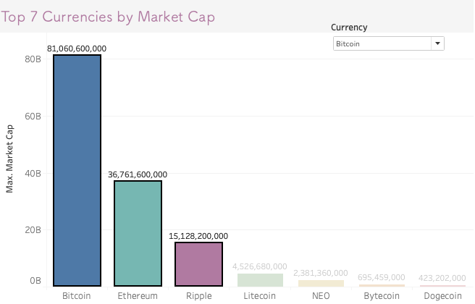




How much will Bitcoin, Ethereum, and Ripple’s market value be worth in the last quarter of 2017 using forecasting and MA?
(currency).csv
Data Cleansing
Exploratory Data Analysis
Key Insights
The top 3 performing cryptocurrencies are Bitcoin, Ethereum, and Ripple
Insights & Recommendations
Source: Top 100 Cryptocurrency Historical Data
Notes:
Drilling down further, we want to determine which currencies have had the best performance based on the maximum recent market cap. In descending order, we have Bitcoin, Ethereum, Ripple, Litecoin, NEO, Bytecoin, and Dogecoin as the best performers.
From this, I personally chose to focus on the top 3 being Bitcoin, Ethereum, and Ripple.
Now that we have a more specific problem, I will go over my approach starting with where I sourced my data for this analysis. I used a Kaggle dataset with a csv for each currency
From there, I performed data cleansing using Jupyter and Python to prevent any muddled or inaccurate analysis.
Subsequently, I went into my exploratory data analysis where I determined the main characteristics of the crypto data using Jupyter and Tableau. I will show you and our investors what the forecasted closing price will be for each of the 3 currencies after September and how to determine where to buy and sell crypto stock using moving averages.
Finally, I’ll go over my insights and recommendations from these characteristics
To kick things off, I’ll start with the top performer Bitcoin

Slide 4
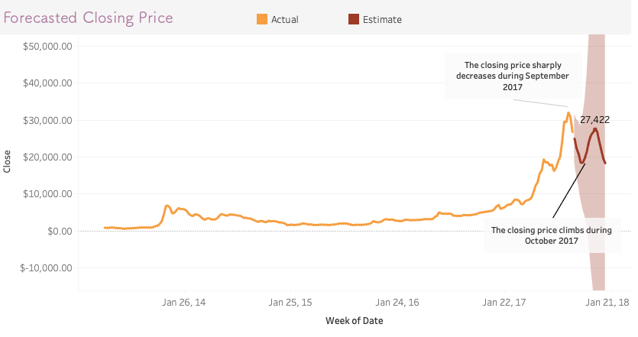
Out of the 3 currencies, Bitcoin has the highest market cap increasing 290% between 2016 & 2017. However, forecasting shows us a downward trend for Bitcoin closing price in the next month.
Key Insights
The closing price for Bitcoin decreases by ~43% in the next month which will cause a loss in investment
After the downward trend, Bitcoin closing price increases by ~30% in the following month which will stabilize investments
Source: Bitcoin stock market data (2013-2017)
Notes:
Bitcoin has the highest market cap increasing 290% between 2016 & 2017. However, forecasting shows us a downward trend for Bitcoin closing price in the next month.
We can see this in the line chart that shows the yellow line being the actual price and the red line representing the forecasted or estimated closing price. Keep in mind that the other 2 currencies I’ll be talking about have this same chart to describe the closing price trend from 2013 to September 2017.
But coming back to Bitcoin, we can observe that the closing price for the currency reaches its maximum on August 27, 2017 at $32,084. This is important because the price is expected to decrease by 30% to $18,441 by October 15. In other words, if you did not sell your crypto stock before the maximum price, there will be a loss in investment until October 15.
However, this may or may not be relevant based on your risk factor and if you’re a short-term and long-term investor. If you’re a short-term investor, this may hurt your investments whereas if you’re a long-term investor this may not hurt as much because the price is expected to increase back up by about 30% to $27,422. Bitcoin has also experienced an unprecedented growth of over 1000% this year alone so it is worth holding onto.

Slide 5
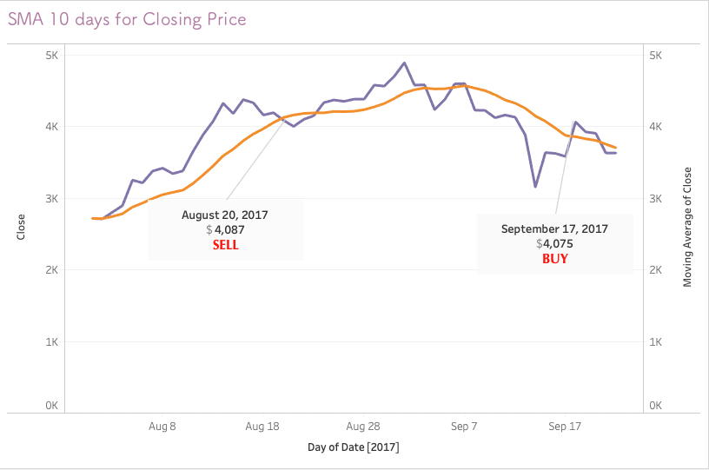

Comparing forecasted and actual closing price gives us an idea where to buy and sell cryptocurrency stock.
Key Insights
There is a selling signal once actual price dips below the forecasted price.
There is a buy signal once the actual price hovers above the forecasted price.
Source: Bitcoin stock market data (2013-2017)
Notes:
After forecasting the last quarter of 2017, we can now determine when to buy or sell your crypto stocks using simple moving averages which is calculated by adding recent prices then dividing that figure by 10 days in this case.
This is the second type of chart shown to describe each currency starting with Bitcoin. Using the period between August and October 2017, I’ve plotted the closing price shown in purple along with the moving average of closing price. Shown in yellow
Notice that the moving average line is smoother compared to the regular closing price line. By smoothing out our closing price, we have a better view of Bitcoin’s closing price trend. This also helps reduce volatility and risk in our closing price data.
Moreover, buy or sell signals are generated when the two lines intersect. When the closing price line moves above the moving average from below, we have a buy signal. Similarly, when the price crosses the moving average from above, a sell signal is generated. These signals are important to prevent any future loss in your investment or to indicate opportunities to increase your investment returns as a short-term or long-term investor. We’ll see a similar trend with our next currency.

Slide 6
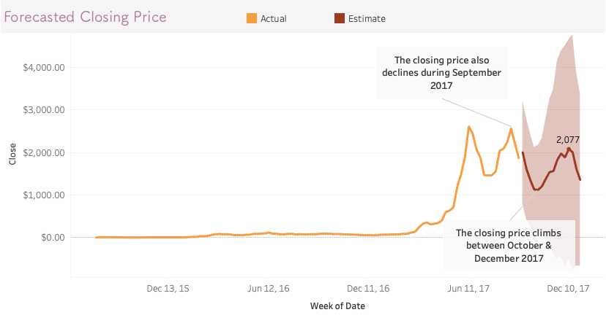
Ethereum has the second highest market cap. However, forecasting shows us a trend like Bitcoin’s during the same time period.
Key Insights
The closing price for Ethereum decreases by ~56% in the next month
After the downward trend, Ethereum’s closing price increases by 46%
Source: Ethereum stock market data (2013-2017)
Notes:
Our runner-up best performer is Ethereum with a market cap of $36,761,600,000.
For Ethereum, forecasting shows us a trend that looks like Bitcoin’s after September. Its maximum closing price before its dip is $2,564.56. After this period, closing price is expected to decrease by 56% to $1,119.94 by October 15.
If you’re a short-term investor, this may hurt investments because the decrease in price is higher than Bitcoin’s percentage-wise. Keep in mind that Ethereum is considerably less costly compared to Bitcoin though. If you’re a long-term investor, Ethereum’s price is expected to increase by 46% to $2,076.62. It does not stabilize like Bitcoin’s price does, but Ethereum is still attractive because it has shown the same level of growth as Bitcoin.

Slide 7
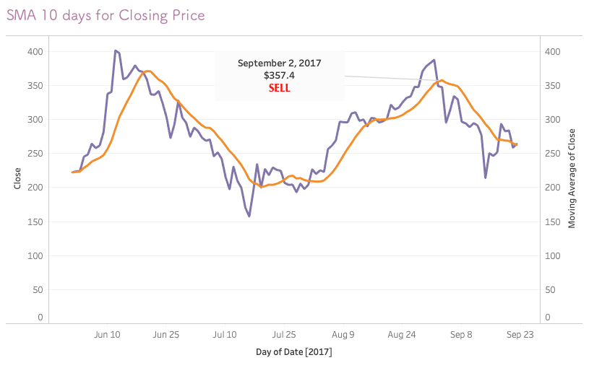
Like Bitcoin, Ethereum experiences a significant dip in its closing price beginning in September 2017.
Key Insights
There is selling signal once the actual closing price of Ethereum dips below the forecasted closing price on 9/2.
Source: Ethereum stock market data (2013-2017)
Notes:
Using what we have learned from moving averages with Bitcoin, we can assess any buy or sell signals for Ethereum as well.
Like I mentioned previously, Ethereum is expected to decrease in price in September. Using SMA, we can see a selling signal on September 2, 2017 when the purple closing price is just about to intersect the yellow moving average of closing price from above. This is important because if you’re a short-term investor, there is a loss of investment until September 17 when the actual price intersects the forecasted price from below.
If you’re a long term-investor this dip is inconsequential as the price dips by about 20% before it increases in price like I’ve shown in the previous slide.
This concludes my insights for Bitcoin and Ethereum. Now I’ll go into the final best performer, Ripple

Slide 8
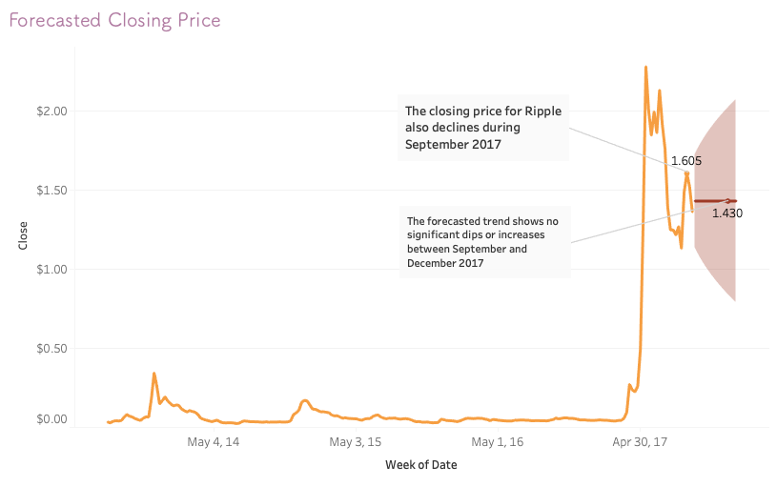
Ripple has the third highest market cap. Forecasting shows us a stagnant trend where there is no increase or decrease in closing price.
Key Insights
The closing price for Ripple decreases by ~11% after August 2017
There is no forecasted upward or downward trend
Source: Ripple stock market data (2013-2017)
Notes:
Ripple has the third highest market cap at $15,528,200,000. Unlike Bitcoin and Ethereum, Ripple reaches its maximum price before September on May 14 at $2.28. After this, Ripple price decreases to $1.61 by September where we see another dip forecasted to decrease the price even further by 11% down to $1.43.
Another contrast with Bitcoin and Ethereum, is that there is no noticeable trends in the red forecasted line so this forecast does not look to be as useful other than the 11% decrease in closing price we now know of.
This is where different moving averages would come in handy as moving averages can also create the red forecasted line. However, due to Tableau limitations, I was only able to show the simple moving average version.
I decided to test a different approach in my Jupyter Notebook, and it turns out using a custom weighted moving average has 2% less error compared to sma used to forecast Ripple. Utilizing different approaches is crucial for this stock analysis and your investment because exclusively using naïve moving average techniques can lead to these flat forecasted lines that don’t prepare us for potential buying or selling points.
Finally, I’ll go over Ripple’s 10 day moving average.

Slide 9
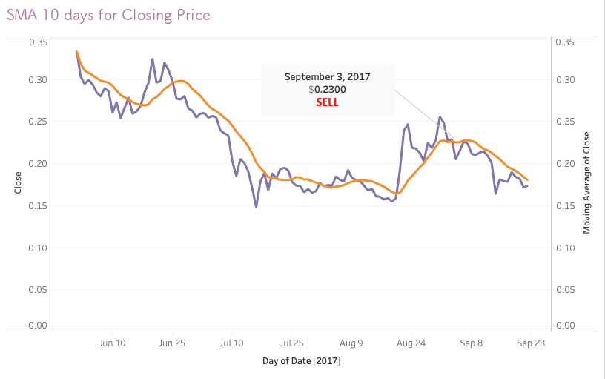
Like Ethereum, Ripple experiences a significant dip in its closing price beginning in September 2017.
Key Insights
There is selling signal once the actual closing price of Ripple dips below the forecasted closing price on 9/3.
Source: Ripple stock market data (2013-2017)
Notes:
Like Ethereum and Bitcoin, Ripple shows a sell signal at the beginning of September when the purple closing line intersects the yellow MA line from above.
Unfortunately, this trend is forecasted to continue until the end of this last quarter but implementing another moving average technique could show us a different story for the last quarter. If you’re a short-term or long-term investor of Ripple, this is probably going to affect you the least out of the 3 currencies since the price of Ripple is significantly cheaper at 17 cents
Now that I’ve looked at all these currencies, I will go over my insights and recommendations for you and the business.

Slide 10
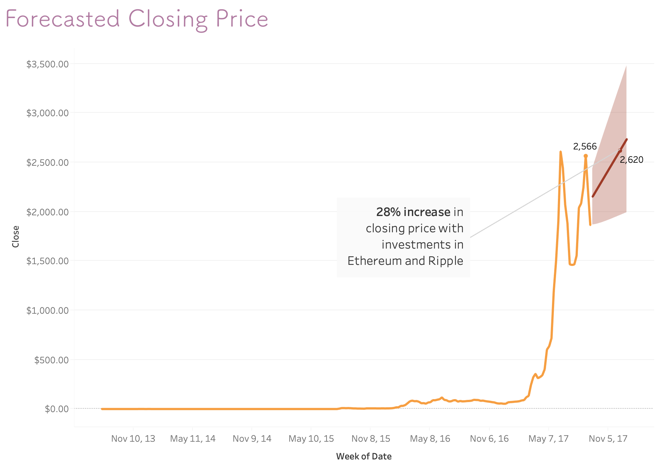
Insights & Recommendations
Insights
Bitcoin and Ethereum’s ongoing trend is expected to bring 56% loss from September to January
Ripples forecasted trend will be more linear compared to the previous 2 currencies. There is a 11% loss from September to January
Recommendations
Diversify cryptocurrency investments into Ripple, Litecoin, NEO, and other high performing cryptocurrencies not included in the top 3
Sell cryptocurrency stocks for Bitcoin and Ethereum before the dip occurs
Source: Top 100 Cryptocurrency Historical Data
Notes:
The most important insights we can gather from this analysis is that Ethereum and Litecoin’s ongoing trend is expected to bring a 56% loss in investment from September to January.
For Ripple, it follows Ethereum and Litecoin but the decrease is only 11% from September to January. These insights show us that we should not put all our eggs in one basket. In other words, we shouldn’t just invest in top performers with higher buy-ins.
My recommendation to mitigate this is to diversify cryptocurrency investments into Ripple, Litecoin, NEO, and other high performing cryptocurrencies not included in the top 3. This will ensure that a big decrease in price like Bitcoin and Ethereum’s will be cushioned by more investments in cheaper currency.
Take the line chart on the right, after investing in just Ethereum and Ripple and filtering out Bitcoin, there is forecasted 28% increase in closing price. This combination yields a positive investment and we can mix and match different currencies like this with the dashboard I created.
My other recommendations is to maybe sell cryptocurrency shares in Bitcoin and Ethereum before their forecasted dip occurs. Note that this is recommended if you’re thinking about reinvesting in other currencies as a short-term or long-term investor.
To wrap up my analysis, we now know the forecasted trend of Bitcoin, Ethereum, and Ripple closing price, we have learned how to buy or sell our shares thanks to MA, and I’ve given my insights and recommendations to you as it relates to our business at DeCent. Thank you for listening and happy investing.

